Slide 1
UNIT FOUR
RELATIONAL MODEL: LOGICAL DATABASE DESIGN

Slide 2
4. 1. Logical Database Design
It is the phase to choose a DBMS to implement our database design, and convert the conceptual database design into a database schema.
Consider relational DBMSs, and therefore, the task in the logical design phase is to convert an ER diagram into a relational database schema.
It is the phase to create the database in a given DBMS
The following are the major activities performed in the logical design phase:
Transform conceptual design criteria into relational form.
Transform entities into tables.
Transform entity attributes into table columns.
Transform tables and columns using rules of functional dependencies and keys or normalization.

Slide 3
4. 1. Logical Database Design------
Logical Database Design has a low-level description of entities that are defined and how they are related to each other and what kind of data is to be stored.
This model determines if all the requirements of the business have been gathered.
Logical database design is the process of determining the logical data structures that are required to support information resources within an organization.
The logical design process helps you to implement a database that satisfies the requirements of your business organization.
Generally, Logical database design is the process of transforming (or mapping)
conceptual schema of the application domain into a schema for the data model.

Slide 4
4. 1. Logical Database Design-------
This mapping can be understood as the result of trying to achieve two distinct sets of goals:
Representation:
Preserving the ability to capture and distinguish all valid states of the conceptual schema;
Data Management:
Addressing issues related to the ease and cost of querying the logical schema, as well as costs of storage and constraint maintenance.
This entry focuses mostly on the mapping of (Extended) Entity-Relationship (EER) diagrams to relational databases

Slide 5
4.2 Objectives of Logical Design...
Translate the conceptual design into a logical database design that can be implemented on a chosen DBMS
Input: conceptual model (ERD)
Output: relational schema or model, normalized relations
Normalization
Analysis of functional dependencies between data items to result in a structure of data that is simple, stable, and fundamental
Resulting database must meet user needs for:
Data sharing,
Ease of access and
Flexibility

Slide 6
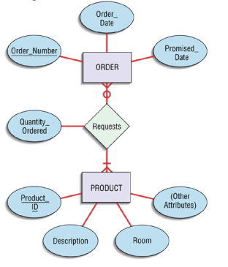
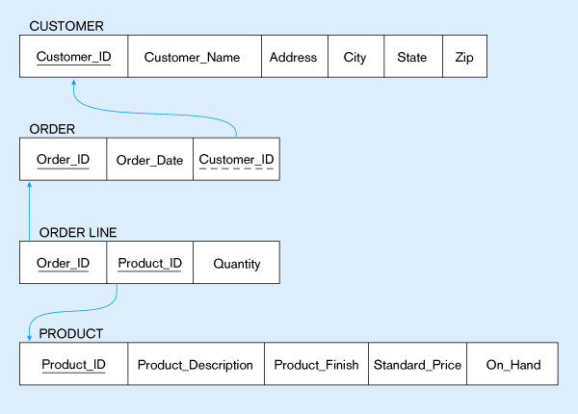
4.2 Objectives of Logical Design...
E-R Diagram
Relational Data Model

Slide 7
4.3 Relational Database
A relational database stores and organizes data points that are related to one another.
Based on the relational database model, a relational database presents
data sets as a collection of tables and
provides relational operators to manipulate the data in tabular form.
Relational databases maintain data in tables, providing an efficient, intuitive, and flexible way to store and access structured information.
Tables, also known as relations, consist of columns
containing one or more data categories, and rows, also known as table records, containing a set of data defined by the category.

Slide 8
4.3 Relational Database------
Applications access data by specifying queries, which use operations such as project to identify attributes, select to identify tuples, and join to combine relations
How Does a Relational Database Work?
Relational Databases use tables to store data about related objects.
Each column contains data attributes, whereas each row holds a record of unique data known as Key.
Relational Databases or RDBMS are managed using SQL short form for Structured Query Language.
Therefore SQL codes are used to retrieve information from relational databases by doing various interactive operations like JOIN, TRUNCATE, etc.

Slide 9
4.3 Relational Database------
A relational database consists of a collection of tables
Each table has a unique name
Each row represents a single entity
A table corresponds to the mathematical concept of a relation
Relations corresponds to tables
Tuples corresponds to rows
The key construct in the relational model is a relation
A DB is a collection of relations
Relations consist of a relation instance and a relation schema
A relation instance corresponds to an actual table with a set of rows
A relation schema consists of the column headings of the table

Slide 10
4.3 Relational Database------
A. Relation Schema
A schema describes
The relation's name
The name of each column in the table, also known as a field, or attribute
The domain of each field
Each domain has a set of associated values like a type
For example, the Customer relation on the next slide
Customer = (CID, fname, lname, age, income)
The schema should also specify the domain of each attribute
Notes:
Domains are data type definitions that resolve to a primitive data type or another domain.
In relational database terminology, a domain defines the permitted range of values for an attribute of an entity.

Slide 11
4.3 Relational Database------
Relation schema: Customer (cid, fname, lname, age, salary)
CID | fname | lname | age | salary
111 | Lemma | Abebe | 23 | 43000.00
222 | zeleke | Tesema | 22 | 6764.87
333 | Tesema | kemal | 47 | 71098.65
444 | kider | mume | 17 | 4033.32
Relation instance
Each field (attribute) has a domain: char(11), char(20), char(20), integer, real
A domain of a field is similar to the type of a variable
The values that can appear in a field are restricted to the field's domain

Slide 12
4.3 Relational Database------
B. Relation Instance
A relation instance is a set of tuples, or records
Each tuple has the same number of fields as the schema
No two rows (tuples) are identical
As each relation is defined to be a set of unique tuples or rows
A set is a collection of distinct values
The order of the rows is not important

Slide 13
4.3 Relational Database------
More On Relationships
The degree of a relation is the number of fields (or columns)
The degree of the Customer relation is 5
The cardinality of a relation instance is the number of tuples in it
The cardinality of the Customer relation instance is 4
A relational database is a collection of relations with distinct relation names
A relational database schema is the collection of schemas for all relations in the database

Slide 14
4.4 Relational Data Model
It is a model that represents data as a set of related tables or relations.
A named, two-dimensional table of data.
Each relation consists of a set of named columns and an arbitrary number of unnamed rows.
The following are some of components of Relational data Model:
The components of the Relational Data Model:
Relations,
Fields or Columns and Tuples,
Degree and Cardinality,
Relation Keys and
Constraints

Slide 15
4.4 Relational Data Model--------
1.Relation
A relation is a named, two-dimensional table of data
Table consists of rows (records), and columns (attribute or field)
Requirements for a table to qualify as a relation:
It must have a unique name.
Every attribute value must be atomic (not multivalued, not composite)
Every row must be unique (can’t have two rows with exactly the same values for all their fields)
Attributes (columns) in tables must have unique names
The order of the columns must be irrelevant

Slide 16
4.4 Relational Data Model--------
2. Key Fields or Relation Keys
Relational database uses primary keys and foreign keys to maintain relationships
Primary keys are unique identifiers of the relation in question.
Examples include employee numbers, social security numbers, etc.
This is how we can guarantee that all rows are unique
Foreign keys are identifiers that enable a dependent relation (on the many side of a relationship) to
refer to its parent relation (on the one side of the relationship)
Keys can be simple (a single field) or composite (more than one field).
However in logical database design the key must be atomic.
Notes:
Atomic key is that kind of Primary key which cannot decomposed. which means that this key is not divided further, like Student_ID,Employee_ID.

Slide 17
Primary Key
Foreign Key (implements 1:N relationship between customer and order)
Combined, these are a composite primary key (uniquely identifies the order line)…individually they are foreign keys (implement M:N relationship between order and product)

Slide 18
4.4 Relational Data Model--------
3. Constraints
Constraints are guidelines or limitations imposed on database tables to maintain the integrity, correctness, and consistency of the data.
Constraints can be used to enforce data linkages across tables,
verify that data is unique, and stop the insertion of erroneous data
In Relational Database Model, constraints refer to limitations placed on data or data processes.
This indicates that only a particular type of data may be entered into the database or
that only a particular sort of operation can be performed on the data inside.

Slide 19
4.4 Relational Data Model--------
The following can be guaranteed via constraints:
A. Data Accuracy:
Data accuracy is guaranteed by constraints, which make sure that only true data is entered into a database.
For example,
a limitation may stop a user from entering a negative value into a field that only accepts positive numbers.
B. Data Consistency:
Constraints are able to ensure that the primary key value in one table is followed by the foreign key value in another table.

Slide 20
4.4 Relational Data Model--------
C. Data Integrity:
The accuracy and completeness of the data in a database are ensured by constraints.
For example, a constraint can stop a user from putting a null value into a field that requires one.

Slide 21
4.4.1 Types of Constraints------
Domain Constraints
Key Constraints
Entity Integrity Constraints
Referential Integrity Constraints
1. Domain Constraints
Guidelines or limitations that specify the acceptable values for a certain property or field.
These restrictions guarantee data consistency and
aid in preventing the entry of inaccurate or inconsistent data into the database.

Slide 22
4.4.1 Types of Constraints------
The following are some instances of domain restrictions in a Relational Database Model:
1.1 Data type Constraints:
These limitations define the kinds of data that can be kept in a column.
A column created as VARCHAR can take string values,
but a column specified as INTEGER can only accept integer values.
1.2 Length Constraints:
These limitations define the largest amount of data that may be put in a column.
For instance, a column with the definition VARCHAR(10) may
only take strings that are up to 10 characters long.

Slide 23
4.4.1 Types of Constraints------
1.3 Range Constraints:
The allowed range of values for a column is specified by range restrictions.
A column designated as DECIMAL(5,2), for example, may only take decimal values up to 5 digits long, including 2 decimal places.
1.4 Nullability Constraints:
Constraints on a column's capacity to accept NULL values are known as nullability constraints.
For instance, a column that has the NOT NULL definition cannot take NULL values.
1.5 Check Constraints:--Constraints for checking data:
These constraints outline a requirement that must hold for any data placed into the column.

Slide 24
4.4.1 Types of Constraints------
For instance, a column with the definition CHECK (age > 0) can only accept ages that are greater than zero.
1.6 Default Constraints:--Constraints by default:
Default constraints automatically assign a value to a column in case no value is provided.
For example, a column with a DEFAULT value of 0 will have 0 as its value if no other value is specified.

Slide 25
4.4.1 Types of Constraints------
2. Key Constraints
Key constraints are regulations or restrictions that a RDM uses
to ensure data accuracy and consistency in a database.
They define how the values in a table's one or more columns are related to the values in other tables,
making sure that the data remains correct.
In Relational Database Model, there are several key constraint:
2.1 Primary Key Constraint:
A unique identifier for each record in a database.
It guarantees that each database entry contains a single, distinct value or a pair of value, that cannot be null, as its method of identification.

Slide 26
4.4.1 Types of Constraints------
B. Foreign Key Constraint:
Reference to the primary key in another table is a foreign key constraint.
It ensures that the
values of a column or set of columns in one table correspond
to the primary key column(s) in another table.
C. Unique Constraint:
In a database, a unique constraint ensures that no two values inside a column or collection of columns are the same.

Slide 27
4.4.1 Types of Constraints------
3. Entity Integrity Constraints
A database management system uses entity integrity constraints (EICs)
to enforce rules that guarantee a table's primary key is unique and not null.
The consistency and integrity of the data in a database are maintained by
EICs, which are created to stop the formation of, duplicate or incomplete entries.
Each item in a table in a relational database is uniquely identified by one or more fields known as the primary key.
EICs make a guarantee that every row's primary key value is distinct and not null.

Slide 28
4.4.1 Types of Constraints------
For example, take the "Employees" table, which has the columns "EmployeeID" is the table's primary key.
An EIC on this table would make sure that each row's unique EmployeeID value is there and that it is not null.
If you try to insert an entry with a duplicate or null EmployeeID,
the database management system will reject the insertion and produce an error.
This guarantees that the information in the table is correct and consistent.
EICs are a crucial component of database architecture and assist guarantee the accuracy and dependability of the data contained in a database.

Slide 29
4.4.1 Types of Constraints------
4. Referential Integrity Constraints
Apply this constraint in order to preserve the consistency and integrity of connections between tables.
By preventing links between entries that don't exist from being created or
by removing records that have related records in other tables,
RICs guarantee that the data in a database is always consistent.
A column or collection of columns in one table that is used as a foreign key to access the primary key of another table.
RICs make sure there are no referential errors and that these relationships are legitimate.

Slide 30
4.4.1 Types of Constraints------
Consider the "Orders" and "Customers" tables as an illustration.
The primary key column in the "Customers" database corresponds to the foreign key field "CustomerID" in the "Orders" dataset.
A RIC on this connection requires that each value in the
"CustomerID" column of the "Orders" database exist in the "Customers" table's primary key column.
If an attempt was made to insert a record into the "Orders" table with a non-existent "CustomerID" value,
the database management system would reject the insertion and notify the user of an error.

Slide 31
4.4.1 Types of Constraints------
Similar to this, the database management system would either prohibit the deletion or cascade the deletion
in order to ensure referential integrity
if a record in the "Customers" table was
removed and linked entries in the "Orders" table.
In general, RICs are a crucial component of database architecture and assist guarantee that,
the information contained in a database is correct and consistent throughout time.

Slide 32
Summary about Referential Integrity Constraints
Referential Integrity
A rule that states that any foreign key value (on the relation of the many side) MUST match a primary key value in the relation of the one side (or the foreign key can be null)
For example: Delete Rules
Restrict – don’t allow delete of “parent” side if related rows exist in “dependent” side
Cascade – automatically delete “dependent” side rows that correspond with the “parent” side row to be deleted
Set-to-Null – set the foreign key in the dependent side to null if deleting from the parent side → not allowed for weak entities

Slide 33
4.5 What is a relational schema?
A relational schema is a blueprint used in database design to represent the data to be entered into the database and
describe how that data is structured in tables (called relations in relational schemas).
The schema describes how those tables relate to each other.
In the relational schema, the table, or relation, consists of a set of named, but unsorted, columns
(called attributes in relational schemas) and
an undefined number of unnamed and unsorted rows (called tuples in relational schemas).

Slide 34
4.5 What is a relational schema?-------
Each row is unique, but the rows can be moved around as needed and stored in any order, modified, or deleted without impacting the efficient operation of the database.
These parts will describe how to convert an ER diagram (or EER diagram) into a corresponding relational schema.
Conceptual database design produces a conceptual ER model.
This conceptual model is then converted into the relational model (which is a logical model).
Note that although it is possible to design using the relational model directly, it is more beneficial to perform conceptual design using the ER model first.

Slide 35
4.5 What is a relational schema?-------
We cannot store data in an ER schema (there are no ER database management systems)
We have to translate our ER schema into a relational schema
In general, these steps convert entities to relations and ER relationships to relations.
For 1:1 and 1:N relationships, foreign keys can be used instead of separate relations.
Handling subclasses and super classes in the EER model requires an extra conversion step.
After conversion is performed, normalization and optimization are often performed to improve the relational schema.

Slide 36
ER-to-Relational Mapping Algorithm
Step 1: Mapping of Regular Entity Types
Step 2: Mapping of Weak Entity Types
Step 3: Mapping of Binary 1:1 Relation Types
Step 4: Mapping of Binary 1:N Relationship Types.
Step 5: Mapping of Binary M:N Relationship Types.
Step 6: Mapping of Multivalued attributes.
Step 7: Mapping of N-ary Relationship Types.
Mapping EER Model Constructs to Relations
Step 8: Options for Mapping Specialization or Generalization.
Step 9: Mapping of Union Types (Categories).

Slide 37
1. Mapping Regular or Strong Entity Type
Convert each Strong entity set to a relation or table
Attributes of the entity type become attributes of the relation.
Include only simple attributes in relation.
For composite attributes, only create attributes in the relation for their simple components.
Multi-valued attributes are handled separately.
The primary key of the relation is the key attributes for the entity
Example 1:
Mapping CUSTOMER entity type with simple attributes
Mapping CUSTOMER entity type with composite attributes

Slide 38
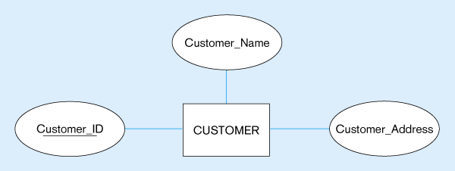
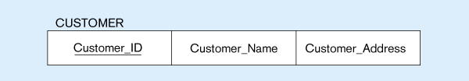
A. Mapping CUSTOMER entity type with simple attributes
Fig. a: Mapping CUSTOMER entity type with simple attributes
Fig.a: CUSTOMER relation Table
CUSTOMER (Customer_ID, Customer_Name, Cutomer_Address)
Fig a: CUSTOMER Relational Schema

Slide 39
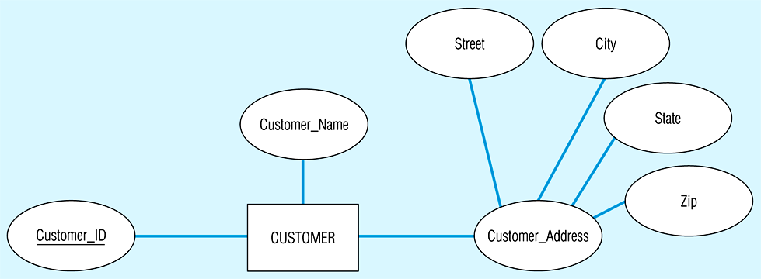
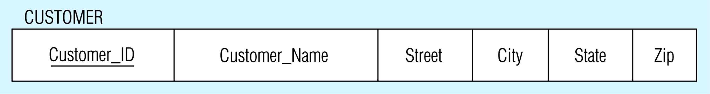
B. Mapping CUTOMER entity type with composite attribute
Fig. b: CUSTOMER entity type with composite attribute
Fig. b: CUSTOMER relation with customer address detail
CUSTOMER (Customer_ID, Customer_Name,Street,City,State,Zip)
Fig b: CUSTOMER Relational Schema for composite keys

Slide 40
2. Mapping Weak Entity
2. Convert each weak entity into a relation with foreign keys to its identifying relations (entities).
For each weak entity W with identifying owners E1, E2, ………,En create a relation R:
Identify relations R1, R2, …,Rn for entity types E1, E2, -------,En
The primary key of R consists of the primary keys of R1, R2, ………,Rn plus the partial key of the weak entity
Create a foreign key in R to the primary key of each relation R1, R2,……….,Rn
Attributes are converted the same as strong entities.

Slide 41
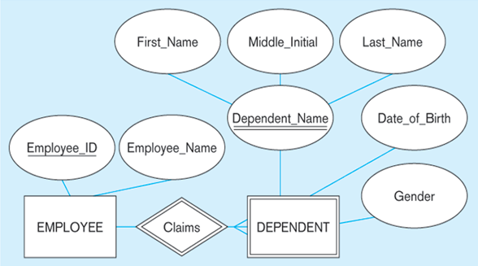
2. Mapping a Weak Entity- Week Entity DEPENDENT in the ER-Diagram below to Relations

Slide 42
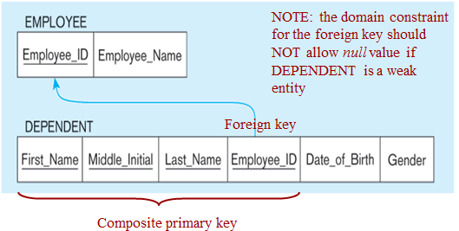
The following is the relational Schema of the previous weak Entity
EMPLOYEE(Employee_ID, Employee_Name)
DEPENDENT(First_Name, Middle_Name, Last_Name, Employee_ID, Date_of_Birth, Gender)

Slide 43
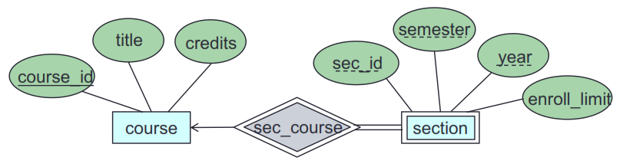
Activity 1
Use the following ER-Diagram and convert the weak entity SECTION dependent on COURSE to relation or relational schema
COURSE (course_id, title, credits)
SECTION(course_id, sec_id, semester, year, enroll_limit)

Slide 44
3. Mapping Binary Relationships
Note that M:N relationships are the most general case, and the conversion algorithm for these relationships can be applied to 1:1 and 1:N as well.
However, for performance reasons, it is normally more efficient to perform different conversions for each relationship type.
In general, each ER relationship can be mapped to a relation.
However, for 1:1 and 1:N relationships, it is more efficient to combine the relationship with an existing relation instead of creating a new one
Relationships that are not binary are handled in step #7 (Mapping of Union Types) or Categories.

Slide 45
3. Mapping Binary Relationships------
3.1 Convert 1:1 relationships into a UNIQUE foreign key reference from one relation to the other.
Given a binary 1:1 relationship R between two entities Ei and Ej.
Identify the corresponding relations Ri and Rj.
Chose one of the relations, say Ri and :
Add the attributes of R to Ri
Add the primary key attributes of Rj to Ri and create a foreign key reference to Rj from Ri.
Declare these primary key attributes of Rj to be UNIQUE
Notes:
You can select either Ri or Rj . Typically, it is best to select the relation that is guaranteed to always participate in the relationship or the one that will participate the most in the relationship

Slide 46
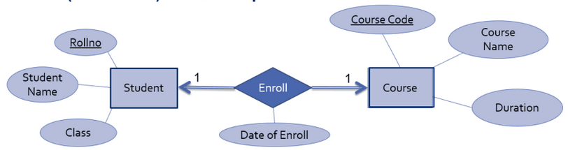
Example 1: Mapping 1:1 Relationship
Consider some relationship set Enroll exist between entity sets STUDENT and COURSE ,which means one STUDENT can Enroll in only one COURSE. Use the following ER-diagram with 1:1 relationship and convert in to relation or relational schema

Slide 47
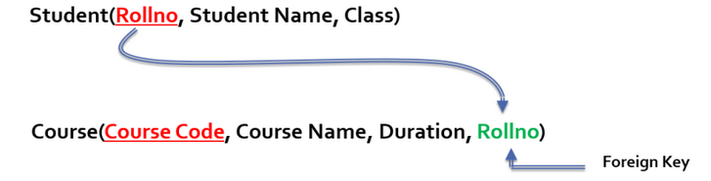
Example 1: Mapping 1:1 Relationship----
To convert this Relationship set into relational schema,
Separate relation is created for all participating entity sets.
Primary Key of relation STUDENT can be act as foreign key for relation COURSE OR Primary Key of relation COURSE act as foreign key for relation STUDENT.
The foreign key reference must be UNIQUE
OR

Slide 48
Example 1: Mapping 1:1 Relationship----
STUDENT(Rollno, Student_Name, Class, Course_Code)
COURSE(Course_Code, Course_Name, Duration)
Foreign Key
Fig: Relational schema for 1:1 relationship between STUDENT and COURSE

Slide 49
3. Mapping Binary Relationships -------
3.2 Convert binary 1:N relationships between into a foreign key reference from the N-side relation to the 1-side relation.
Given a binary 1:N relationship R between two entities Ei and Ej
Identify the corresponding relations Ri and Rj
Let Ri be the N-side of the relation.
Add the attributes of R to Ri
Add the primary key attributes of Rj to Ri and create a foreign key reference to Rj from Ri

Slide 50
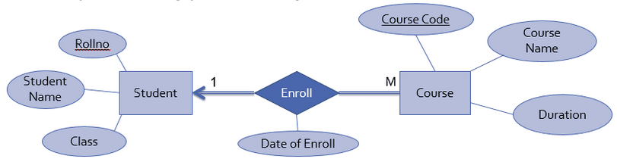
3. Mapping Binary Relationships------
Notes: Unlike 1:1 relationships, you must select the N-side of the relationship as the relation containing the foreign key and relationship attributes
Example 1: Consider 1:N relationship set enrolled exist between entity sets STUDENT and COURSE as follow and convert in to relational schema

Slide 51
3. Mapping Binary Relationships------
Attributes of entity set STUDENT are Rollno which is primary key
Attributes of entity set COURSE are Course_code which is primary key
And date of enroll is attribute of relationship set enroll.
Here Enroll is 1:M relationship exist between entity set STUDENT and COURSE which means that one student can enroll in multiple courses
In this case to convert this relationship into relational schema,
Separate relation is created for all entity sets(STUDENT and COURSE)
Key attribute of Many’s side entity set (COURSE) is mapped as foreign key in one’s side relation (STUDENTS)
All attributes of relationship set are mapped as attributes for relation of one’s side entity set (STUDENT)

Slide 52
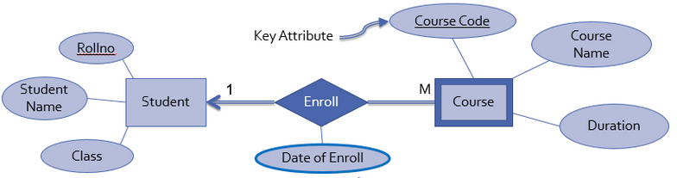

3. Mapping Binary Relationships------

Slide 53
3. Mapping Binary Relationships------
3.3 Convert binary M:N relationships into a new relation with foreign keys to the two participating entities.
Given a binary M:N relationship between entities Ei and Ej.
Identify the corresponding relations Ri and Rj
Create a new relation R representing the relationship where:
R contains the relationship attributes.
The primary key of R is a composite key consisting of the primary keys of Ri and Rj
Add the primary key attributes of Ri and Rj to R, and create a foreign key reference to Ri from R and to Rj from R.

Slide 54
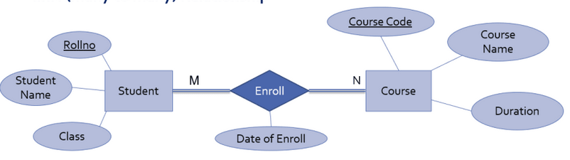
3. Mapping Binary Relationships------
Example 1: Consider same relationship set enrolled exist between entity sets student and course ,which means multiple student can enroll in multiple courses.
To convert this Relationship set into relational schema,
Relationship set is mapped as separate relation
Key attributes of participating entity sets are mapped as primary key for that relation
Attribute of relationship set becomes simple attributes for that relation
And separate relation is created for other participating entities

Slide 55
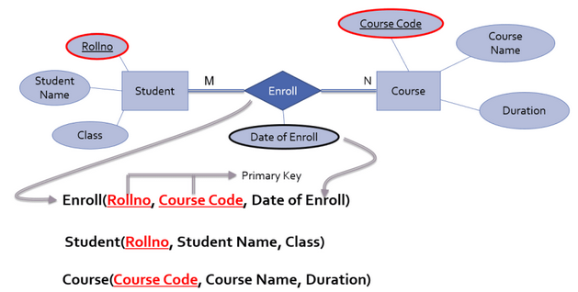
3. Mapping Binary Relationships------

Slide 56
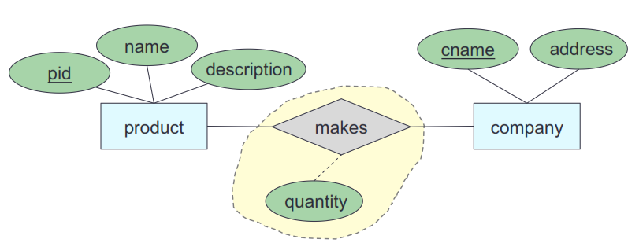
Activity
Consider the M:N relationships makes shown in the following ER-Diagram between COMPANY and PRODUCT and convert into relational schema.
PRODUCT(pid, name, description)
COMPANY(cname, address)
MAKES(pid, cname, quantity)

Slide 57
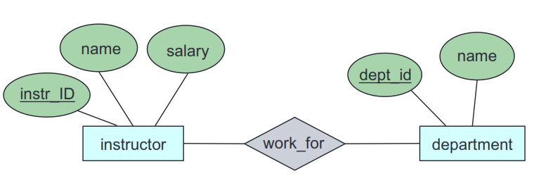
Activity----
Consider the M:N relationships works_for shown in the following ER-Diagram between INSTRUCTOR and DEPARTMEN and convert into relational schema.
INSTRUCTOR (instr_ID, name, salary)
DEPARTMENT (dept_id, name)
WORKS_FOR (instr_ID, dept_id)

Slide 58
6. Mapping Multi-Valued Attributes
Convert a multi-valued attribute into a relation with composite primary key consisting of the attribute value plus the primary key of the attribute's entity.
Given a multi-valued attribute A of entity Ei
Identify the corresponding relation Ri
Create a new relation R representing the attribute where:
R contains the simple, single-valued attribute A.
Add the primary key attributes of Ri to R, and create a foreign key reference to Ri from R.
The primary key of R is a composite key consisting of the primary key of Ri and A

Slide 59
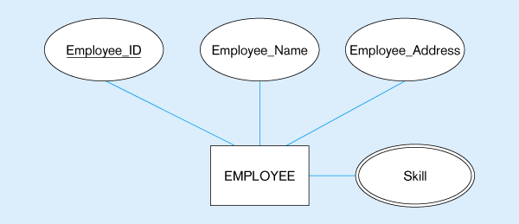
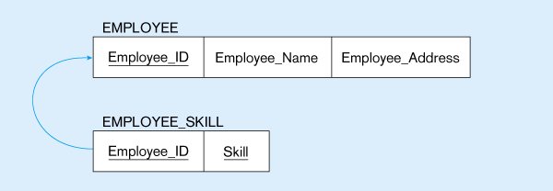
Fig c: Mapping a Multivalued Attribute
(b)
Fig c: Multivalued attribute becomes a separate relation with foreign key
1–N relationship between original entity and new relation

Slide 60
4.6 Functional Dependencies
A functional dependency is a constraint between two sets of attributes from the database.
Functional Dependency hold when:
The value of one attribute (the determinant) determines the value of another attribute.
Among the candidate keys in a relational schema, one of the candidate keys will become the primary key
Each non-key field is functionally dependent on every candidate key.
The concepts of functional dependencies is the basis for the first three normal forms.

Slide 61
4.6 Functional Dependencies--------
A column, Y, of the relational table R is said to be functionally dependent up on column X of R:
If and only if each value of X is associated with precisely one value of Y at any given time. OR
When values of attribute B can be derived from the attributes A1, . . . ,An we say that B is functionally dependent on A1, . . . ,An.
This is written as follows: A1, A2 . . .An → B
Definition:
A functional dependency, denoted by X Y, between two sets of attributes X and Y that are subsets of R specifies a constraint on the possible tuples that can form a relation state r of R.

Slide 62
4.6 Functional Dependencies-------
The constraint is that, for any two tuples t_{l} and t₂ in r that have t₁[X] = t₂[X], they must also have t₁[Y] = t₂[Y] .
This means that:
The values of the Y component of a tuple in r depend on, or are determined by, the values of the X component;
Alternatively, the values of the X component of a tuple uniquely (or functionally) determine the values of the Y component.
We also say that there is a functional dependency from X to Y, or that Y is functionally dependent on X.
The abbreviation for functional dependency is FD or f.d.

Slide 63
4.6 Functional Dependencies-------
The set of attributes X is called the left-hand side of the FD, and Y is called the right-hand side.
Thus, X functionally determines Y in a relation schema R if, and only if, whenever two tuples of r(R) agree on their X-value, they must necessarily agree on their Y-value.
For example, knowing the STU_NUM in the STUDENT table means that you are able to determine that student’s last name, grade point average, phone number, and so on
“A determines B” is written as A → B.
If A determines B, C, and D, you write A → B, C, D.

Slide 64
4.6 Functional Dependencies-------
Therefore, using the attributes of the STUDENT table can represent the statement “STU_NUM determines STU_LNAME” by writing:
STU_NUM → STU_LNAME
In fact, the STU_NUM value in the STUDENT table determines all of the student’s attribute values.
For example, you can write:
STU_NUM → STU_LNAME, STU_FNAME, STU_INIT and
STU_NUM → STU_LNAME, STU_FNAME, STU_INIT, STU_DOB, STU_TRANSFER

Slide 65
4.6 Functional Dependencies-------
In contrast, STU_NUM is not determined by STU_LNAME because it is quite possible for several students to have the same last name.
The principle of determination is very important because it is used in the definition of a central relational database concept known as functional dependence.
The term functional dependence can be defined most easily this way:
The attribute B is functionally dependent on A if A determines B. More precisely:
The attribute B is functionally dependent on the attribute A if each value in column A determines one and only one value in column B.

Slide 66
4.6 Functional Dependencies-------
Using the contents of the STUDENT table, it is appropriate to say that STU_PHONE is functionally dependent on STU_NUM.
Because:
The STU_NUM value such as 324273 determines the STU_LNAME value Smith.
But the STU_NUM value is not functionally dependent on STU_LNAME because more than one student may have the last name Smith.

Slide 67
4.7 Normalization
Designing an optimal database design is an important element of:
Database operations,
Achieving maximum performance and flexibility while working with tables and data.
To minimize errors and duplication of data.
To achieve all these use Normalization.
Normalization is a process that involves to split larger multicolumn tables into two or more smaller tables to have fewer columns.
The normalization process typically consists of no more than five steps with each succeeding step subscribing to the rules of the previous steps but normalizing up to 3NF is enough.

Slide 68
4.7 Normalization-----
A fully normalized database often requires a greater number of joins and adversely affects the speed of queries.
As Celko in his book mentions that the process of joining multiple tables is costly, specifically affecting processing time and computer resources.
Normalization:
is a formal process for deciding which attributes should be grouped together in a relation
is a process for evaluating and correcting table structures to minimize data redundancies and helps to eliminate data anomalies.
Objective: To validate and improve a logical design so that it satisfies certain constraints that avoid unnecessary duplication of data

Slide 69
4.7 Normalization-----
Normalization passes through two-step process:
i) Puts data in a tabular form
ii) Removes duplicated data from the relational tables
A well structured relation is a relation that contains:
i) Minimal data redundancy and
ii) Allows users to insert, delete, and update rows without causing data inconsistencies
The goals of normalization is to avoid anomalies:

Slide 70
The three Normal Forms
The concepts of functional dependencies is the basis for the first three normal forms as we discussed previously.
A column, Y, of the relational table R is said to be functionally dependent up on column X of R if and only if each value of X is associated with precisely one value of Y at any given time.
R.x R.y
Column X functionally determines (defines) column Y
All tables in the relational database should be in the third normal form(3NF).
A relational table is in 3NF if and only all non-key columns are:
Mutually independent and
Fully dependent up on the primary key
Full functional dependence applies to tables with composite keys.

Slide 71
The three Normal Forms
For Example: Column Y in relational table R is fully functional on X of R if:
i) It is functionally dependent on X and
ii) Not functionally dependent up on any subset of X.
Let’s discuss the three types of normal forms based on the following example:
A company obtains parts from a number of suppliers.
Each supplier is located in one city.
A city can have more than one supplier located there
And each city has a status code associated with it.
Each supplier may provide many parts.
The company creates a simple relational table to store this information that can be expressed in relational notations as follows:

Slide 72
FIRST(S#, Status, City,P#, qty), where
S# | Supplier identification number (this is primary key)
Status | Status code assigned to city
City | Name of city where supplier is located
P# | Part number of part supplied
qty | Quantity of parts supplied to date
In order to uniquely associate quantity supplied (qty) with part (p#) and supplier(s#), a composite primary key composed of s# and p# is used.

Slide 73
1. First Normal Form
First normal form (INF), defined to disallow multivalued attributes, composite attributes, and their combinations.
A relational table, by definition, is in the first normal form:
If all values of the columns are atomic. That is, they contain no repeating values.
The following table (FIRST table) shows in the 1NF.
Although, the table FIRST is in the 1NF, it contains redundant data.
For example, information about the supplier’s location and the location’s status has to be repeated for every part supplied.
Redundancy causes what are called update anomalies.

Slide 74
FIRST TABLE
S# | Status | City | P# | qty
S1 | 20 | London | P1 | 300
S1 | 20 | London | P2 | 200
S1 | 20 | London | P3 | 400
S1 | 20 | London | P4 | 200
S1 | 20 | London | P5 | 100
S1 | 20 | London | P6 | 100
S2 | 10 | Paris | P1 | 300
S2 | 10 | Paris | P2 | 400
S3 | 10 | Paris | P2 | 200
S4 | 20 | London | P2 | 200
S4 | 20 | London | P4 | 300
S4 | 20 | London | P5 | 400

Slide 75
Update Anomalies
Update anomalies are problems that arise when information is inserted, deleted, or updated.
For example, the following anomalies could occur in the FIRST table:
a) INSERT:-The fact that a certain supplier (S5) is located in particular city(Athens) can not be added until they supplied a part.
b) DELETE: If a row is deleted, then not only is the information about quantity and part lost but also information about the supplier.
c) UPDATE : If supplier s1 moved from London to New York, then six rows would have to be updated with this new information.

Slide 76
2. Second Normal Form
A relational table is in the 2NF if it is in 1NF (composite primary key can be in 1NF but not in 2NF) and every non-key column is fully dependent up on the primary key.
That is, every non-key column must be dependent upon the entire primary key.
FIRST is in 1NF but not in 2NF because status and city are functionally dependent up on only on the columns s# of the composite key(s#,p#).
This can be illustrated by listing the functional dependencies in the table as follows:

Slide 77
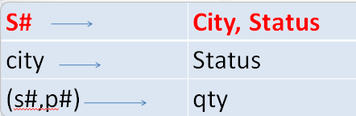
2. Second Normal Form------
The process for transforming a 1NF table to 2NF is done as follows:
Identify any determinants other than the composite key and the columns they determine.
For example, the determinant, City and that determine the status of the city i.e., are outside the composite key
And S#, P# are composite determinant that determines the quantity that the suppliers are supplied.
b) Create and name a new table for each determinant and the unique columns it determines.

Slide 78
2. Second Normal Form------
c) Move the determined columns from the original table to the new table.
The determinate becomes the primary key of the new table.
d) Delete the columns you just moved from the original table except for the determinate which will serve as a foreign key
e) The original table may be renamed to maintain semantic meaning.
Therefore, to transform FIRST in to 2NF we move the columns s#, status, and city to a new table called SUPPLIERS.
The column s# becomes the primary key of this new table.
As a result the table FIRST is decomposed in to two tables (SUPPLERS and PARTS)

Slide 79
PARTS
SUPPLIERS
S# | P# | qty
S1 | P1 | 300
S1 | P2 | 200
S1 | P3 | 400
S1 | P4 | 200
S1 | P5 | 100
S1 | P6 | 100
S2 | P1 | 300
S2 | P2 | 400
S3 | P2 | 200
S4 | P2 | 200
S4 | P4 | 300
S4 | P5 | 400
S# | Status | City
S1 | 20 | London
S2 | 10 | Paris
S3 | 10 | Paris
S4 | 20 | London
S5 | 30 | Athens

Slide 80
2. Second Normal Form------
The above Tables are in the 2NF but not in 3NF still contain modification anomalies.
In the example of SUPPLIERS, they are:
INSERT: The fact that a particular city has a certain status (Rome has a status of 50) can not be inserted until there is a supplier in the city
DELETE: Deleting any row in Supplier destroys the status information about the city as well as the association between supplier and city.
.

Slide 81
3. Third Normal Form
The third normal form requires that all columns in a relational table are dependent only upon the primary key.
A relational table is in third normal form:
If it is already in 2NF and every non-key column is non transitively dependent upon its primary key OR
All non key attributes are functionally dependent only upon the primary key.
The Table PARTS is already in the 3NF because non-key column, qty, is fully dependent up on the primary key(s#,p#).
SUPPLIERS is in 2NF but not in 3NF because it contains a transitive dependency.

Slide 82
3. Third Normal Form-----
A transitive dependency occurs when a non-key column that is a determinant of the primary key is the determinate of other columns.
A relation schema is in 3rd normal form (3NF) if:
Any functional dependency among its attributes is either unavoidable, or has a member of some candidate key on the right hand side.
In other words, a relation is in 3NF if there are no unavoidable functional dependencies among non-candidate key attributes.
It is generally a relation in the 2NF PLUS no transitive dependencies (functional dependencies on non-primary-key attributes).

Slide 83
3. Third Normal Form-----
Note: A dependency is called transitive, because the primary key is a determinant for another attribute, which in turn is a determinant for a third attribute.
What is the Solution?
Non-key determinant with transitive dependencies go into a new table; and
Non-key determinant becomes primary key in the new table and stays as foreign key in the old table.

Slide 84
3. Third Normal Form-----
A relation schema is in 3rd normal form (3NF) if:
Any functional dependency among its attributes is either unavoidable, or has a member of some candidate key on the right hand side.
In other words, a relation is in 3NF if there are no unavoidable functional dependencies among non-candidate key attributes.
It is generally a relation in the 2NF PLUS no transitive dependencies (functional dependencies on non-primary-key attributes).
Note: A dependency is called transitive, because the primary key is a determinant for another attribute, which in turn is a determinant for a third attribute.
What is the Solution?
Non-key determinant with transitive dependencies go into a new table; and
Non-key determinant becomes primary key in the new table and stays as foreign key in the old table.

Slide 85
The concept of transitive dependency can be illustrated by showing the functional dependencies in SUPPLIERS table as follows:
SUPPLIERS.s# SUPPLIERS .status
SUPPLIERS.s# SUPPLIERS.city
SUPPLIERS.city SUPPLIERS .status
Note that SUPPLIERS.status is determined both by the primary key s# and the non-key column city.
The process of transforming a table in to 3NF is:
Identify any determinants, other than the primary key and the column they determine.
Create and name a new table for each determinant and the unique columns it determines
Move the determined columns from the original table to the new table.
Delete the column you just moved from the original table except for the determinate which will serve as a foreign key.
The determinate becomes the primary key of the new table.

Slide 86
To transform SUPPLIERS in to 3NF, we create a new table called CITY_STATUS and move the columns city and status in to it.
Status is deleted from the original table, city is left behind to serve as a foreign key to CITY_STATUS, and the original table is renamed to SUPPLIER_CITY to reflect its semantic meaning .
CITY_STATUS
SUPPLIER_CITY
s# | City
S1 | London
S2 | Paris
S3 | Paris
S4 | London
S5 | Athens
City | Status
London | 20
Paris | 10
Athens | 30
Rome | 50

Slide 87
The result of putting the original table in to 3NF has created three tables.
PARTS(s#,P#,qty)-Primary Key(s#,p#), foreign key(s#) references SUPPLIER_CITY.s#
SUPPLIER_CITY(s#,city)-primary key(s#), foreign key(city) references CITY_STATUS.city
CITY_STATUS(city, status) primary key (city)

Slide 88
SUPPLIER_CITY
PARTS
s# | City
S1 | London
S2 | Paris
S3 | Paris
S4 | London
S5 | Athens
S# | P# | qty
S1 | P1 | 300
S1 | P2 | 200
S1 | P3 | 400
S1 | P4 | 200
S1 | P5 | 100
S1 | P6 | 100
S2 | P1 | 300
S2 | P2 | 400
S3 | P2 | 200
S4 | P2 | 200
S4 | P4 | 300
S4 | P5 | 400
CITY_STATUS
City | Status
London | 20
Paris | 10
Athens | 30
Rome | 50

